Slide 1
Data 601 @ UMBC Class 1: data formats
Data 601
August 30, 2018
These notes are CC BY 4.0
Notes:
See also https://web.stanford.edu/class/stats101/intro/intro-lecture01.pdf for inspiration
Useful: https://arxiv.org/pdf/1503.05570.pdf
A Data Science Course for Undergraduates: Thinking With Data by Ben Baumer, The American Statistician Vol. 69 , Issue. 4

Slide 2
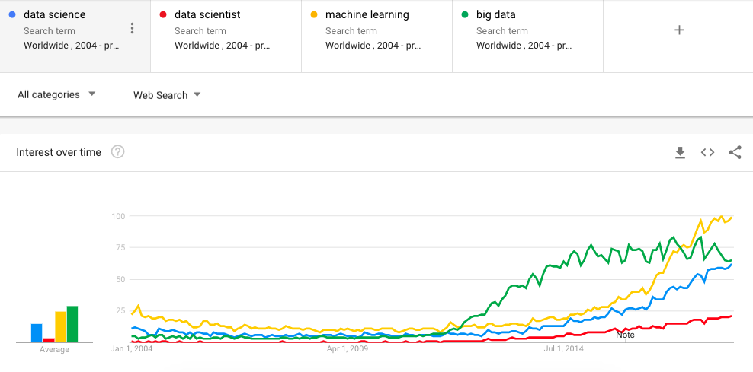
Welcome to Data 601
Once you've found a seat,
Introduce yourself to your neighbor
Ask them what their expectations are for the class
Notes:
https://trends.google.com/trends/

Slide 3
Ground rules
scheduled bio breaks
Also, it is acceptable to get up at any time and take a bathroom break
raise your hand if you have a question
it is acceptable to occasionally not participate
I highly value feedback
See anonymous question sheets on your desk

Slide 4
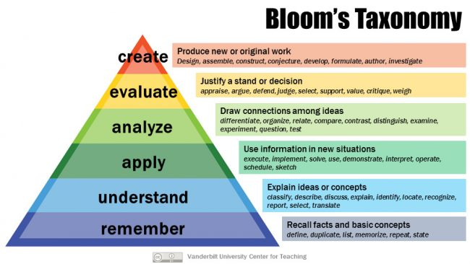
Grading Learning
What you may care about for evaluation
What I care about conveying
Attendance: 10%
Show up for class
Participate in class exercises and surveys
Homework: 30%
When homework is assigned, the due date will be provided
Mid-term project: 30%
Final project: 30%
Includes a presentation to the class

Slide 5
Log your assumptions and expectations
In-class exercise:
On a piece of paper or on your computer, record the date.
Write down your assumptions about this class
Write down your expectations for this class

Slide 6
Log your assumptions and expectations
We will revisit these notes later in the semester
Please store your note where it can be accessed later in the course

Slide 7

What do you want to learn?
Notes:
Image source: https://www.compli.com/blog/survey/

Slide 8
Course schedule and outline (scope)
Aug 30: Overview Data Science
Sept 6: Python in Jupyter
Sept 13: Math (stats)
Sept 20: Regression
Sept 27: Evaluation, cross-validation, overfitting
Oct 4: clustering
Oct 11: [Substitute]
Oct 18: scaling up; transitions
Oct 25: Presentations
Nov 1: getting data
Nov 8: Data cleanup
Nov 15: property graphs
Nov 22: No class (Thanksgiving)
Nov 29:
Dec 6:
Dec 13: Presentation

Slide 9
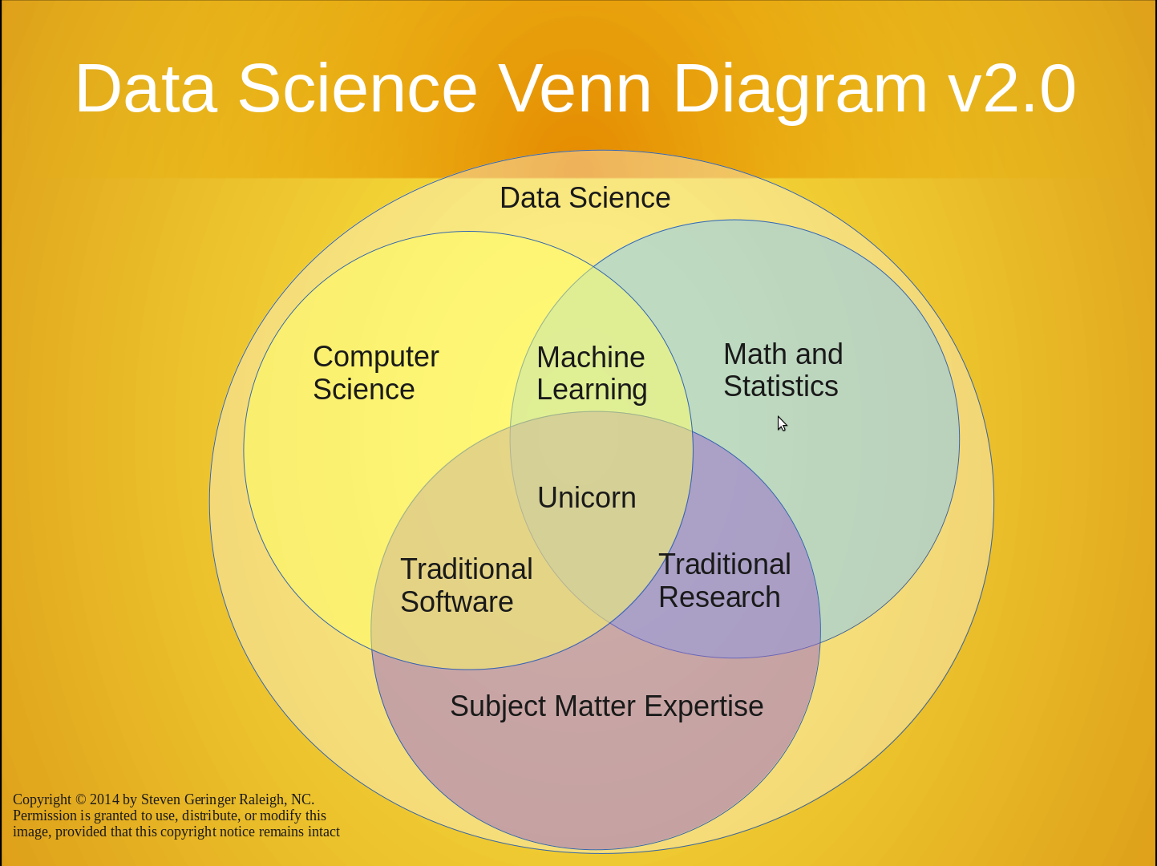
https://www.kdnuggets.com/2016/10/battle-data-science-venn-diagrams.html
There's a lot to cover
Suggested reading:

Slide 10
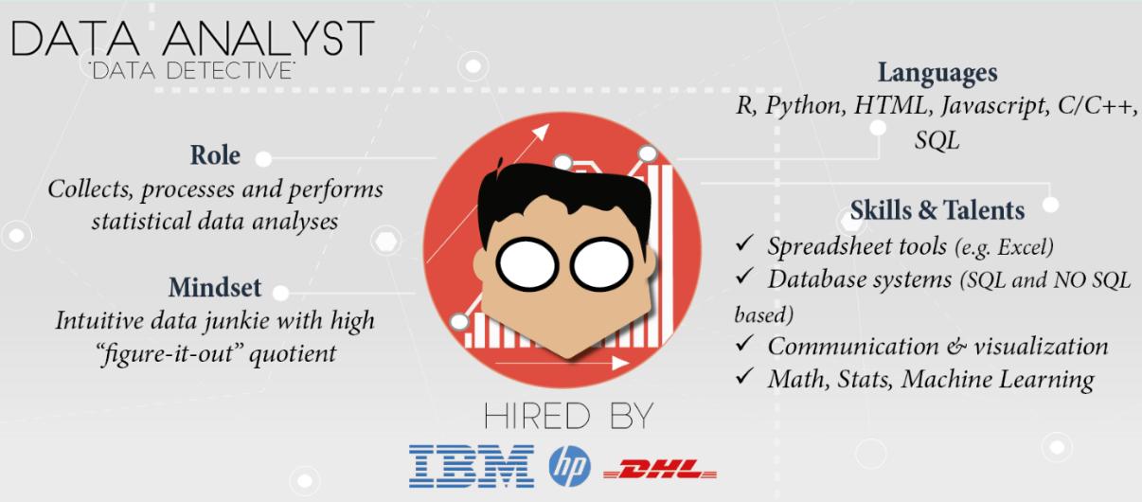
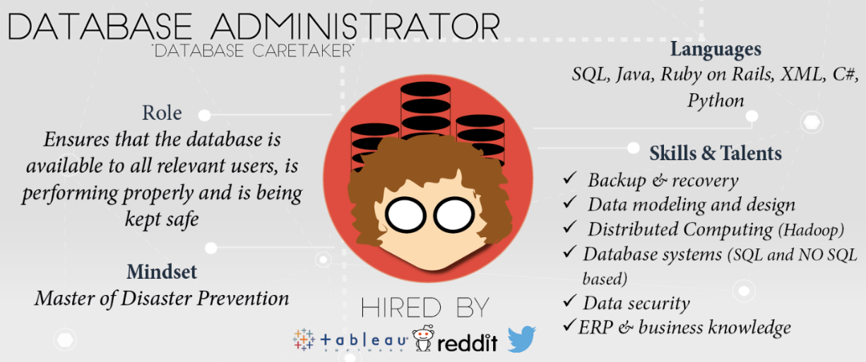
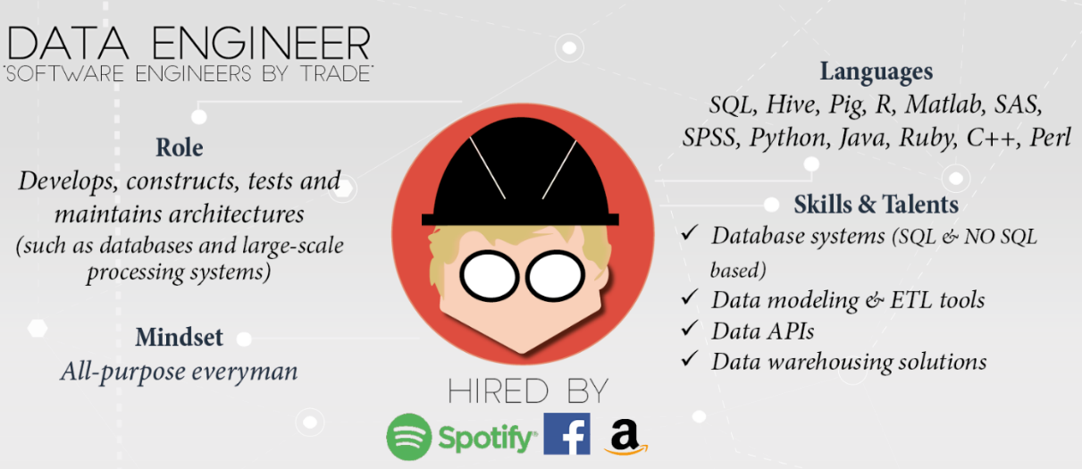
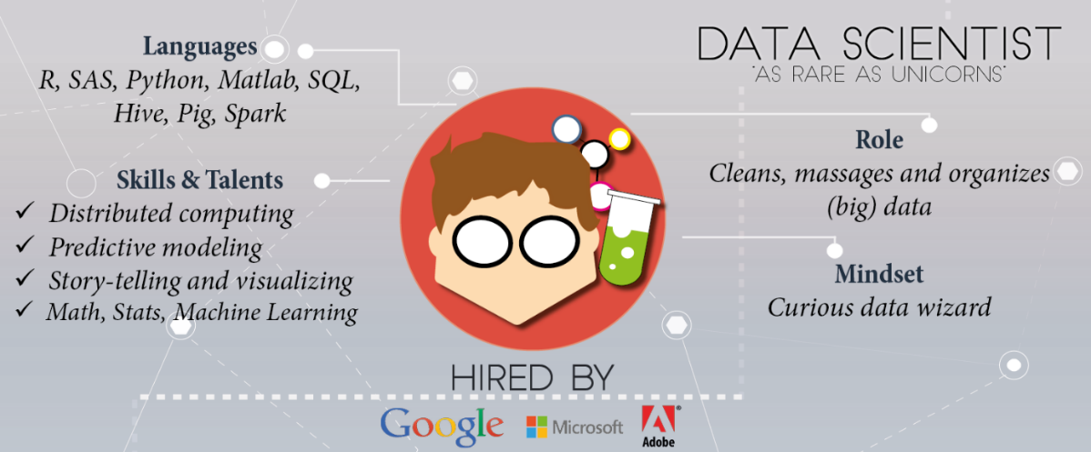
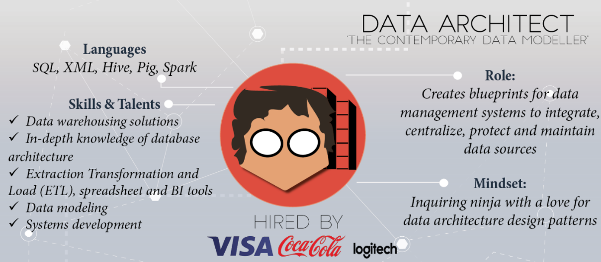
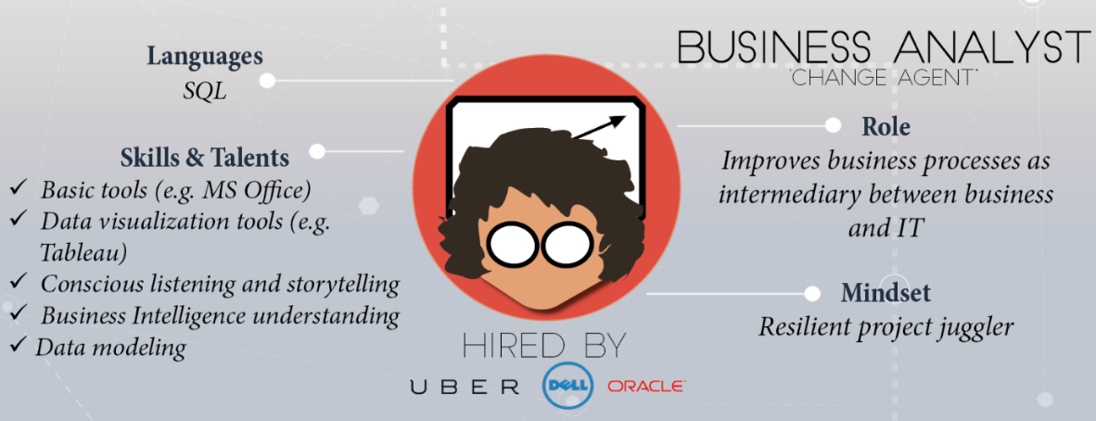
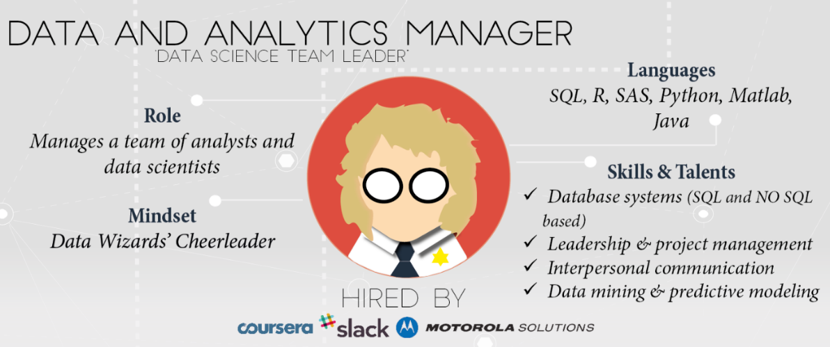
Profusion of title and labels
https://www.datacamp.com/community/tutorials/data-science-industry-infographic
Historical progression: data grooming, data mining, data scientist

Slide 11
Data science is an active field with lots of jargon
There will always be something you haven't heard of before.
Know enough to be conversant with peers
Be curious about new topics
Research concepts and labels before using them
Reference: http://www.datascienceglossary.org/

Slide 12
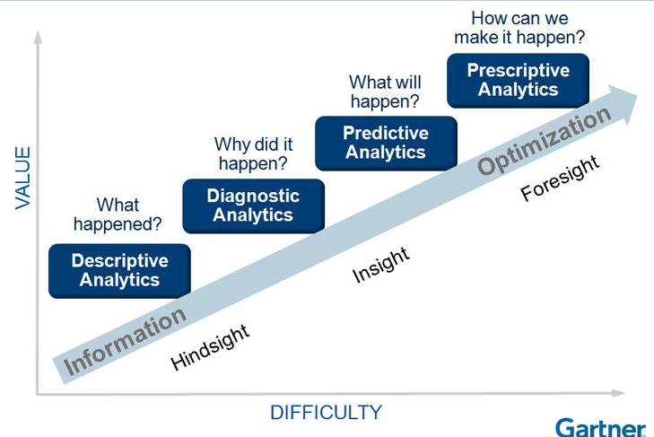
Why learn data science?
Explore: identify patterns​
Predict: make informed guesses​
Infer: quantify what you know
Motives:
Make money
Help people
Gain new knowledge

Slide 13
Large scale use cases with lots of data
Google search engine
Recommendations from Amazon and Netflix
Bank and Credit Card fraud detection
Logistics (DHL, UPS)
Healthcare
Notes:
https://www.thrillist.com/entertainment/nation/how-new-netflix-recommendation-algorithm-works#
https://medium.com/netflix-techblog/artwork-personalization-c589f074ad76
https://www.wired.co.uk/article/how-do-netflixs-algorithms-work-machine-learning-helps-to-predict-what-viewers-will-like

Slide 14
Assumption in this class
In class we will assume you are a lone data scientist on an island with an internet connection.
This is not the typical case -- you'll have coworkers, customers, bosses, competitors, collaborators, peers.
Example:
In this class, grading is not competitive
As an employee at a company, you may be competing for a bonus or promotion
--> consequence: personal and organizational politics factor into the work environment

Slide 15
Small scale use cases with not much data
As a business employee or bureaucrat or politician
How do I improve decision making process?
How do I evaluate the outcome of decisions?
How do I decrease the risk when faced with an opportunity?
How do I convince other stakeholders of the best course of action?
While not taking too much time, spending too much money, using the resources I already have access to, and in a way that is convincing?

Slide 16

Most popular tool in data science
Stand up
Walk around
Introduce yourself to another person
Ask them what they think the most popular software tool in data science is
https://www.trippinsights.com/2018/01/04/milling-about/
Notes:
https://www.trippinsights.com/2018/01/04/milling-about/

Slide 17
Most popular tool in data science
Ben's claim: most popular tool in data science is Excel.
Excel is attractive because it's flexible and capable -- it can store data, the transform, and the visualization.
However, as an analytic ages in Excel and is increasingly tailored, it becomes increasingly brittle.
Also, in the list of capabilities I didn't include documentation.

Slide 18

Most popular tool in Data 601: Python
Notes:
https://me.me/i/mustache-you-a-question-and-please-mullet-over-com-lilahdelilah-4900203

Slide 19

Most popular tool in Data 601: Python
Raise your hand if you have heard of the programming language called Python

Slide 20
Most popular tool in Data 601: Python
Raise your hand if you have used the programming language called Python

Slide 21
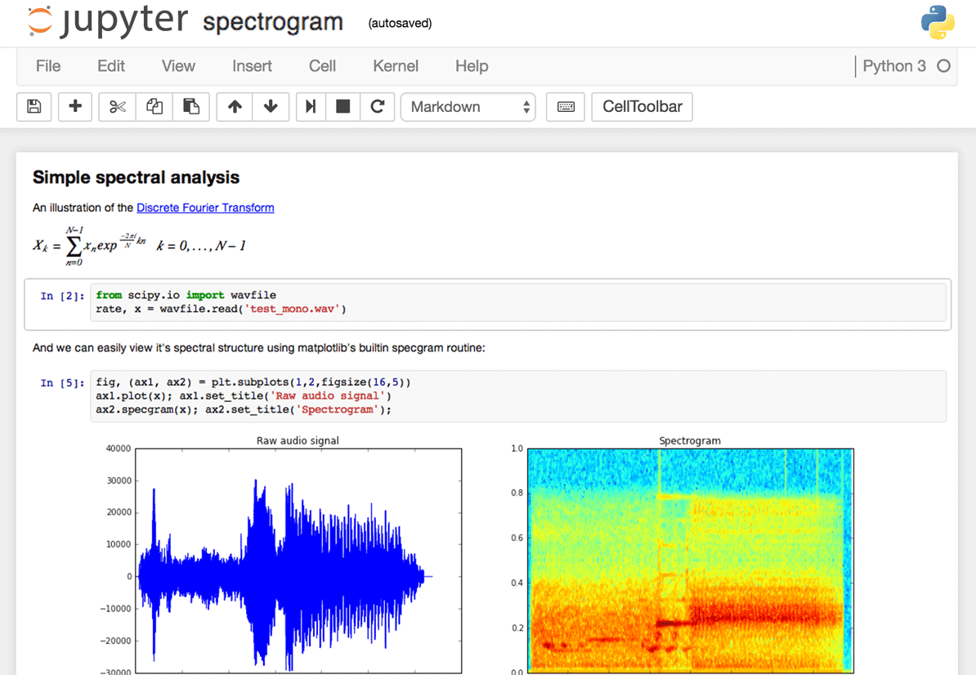
Interface to Python in Data 601: Jupyter
Raise your hand if you have used a Jupyter notebook
Notes:
Image source: https://www.dataquest.io/blog/jupyter-notebook-tips-tricks-shortcuts/

Slide 22

Why Jupyter + Python for Data 601?
Jupyter is useful for
Exploration of data (jargon: EDA = exploratory data analysis)
Documenting your activities (to enable reproducibility)
Figuring out which software is relevant, which algorithms to use, which software libraries are useful
Visualizing results
And both Jupyter and Python are free!
And both are widely used!
Notes:
Image source: https://imgflip.com/memetemplate/68354308/Do-all-the-things

Slide 23
Python and Jupyter do not cover every use case
For sufficiently large data sets, Jupyter and Python are not the right tool
For sufficiently complex analytics, Jupyter and Python are not the right tool
Speed and security are typically not your priority during exploration
Knowing when to invest in switching tools is a skill
Evaluate trade-offs of flexibility and security and speed for a given scale

Slide 24
Processes external to data science
Exploration may be enough and the effort terminates
Notes:
http://www.wiiplaygameslv.com/catalog/board_games-toyvault/but_wait_theres_more/406443

Slide 25

Processes external to data science
Exploration may be enough and the effort terminates
Additional refinement is often needed; data science is often merely the start of an investment
Notes:
http://www.wiiplaygameslv.com/catalog/board_games-toyvault/but_wait_theres_more/406443

Slide 26
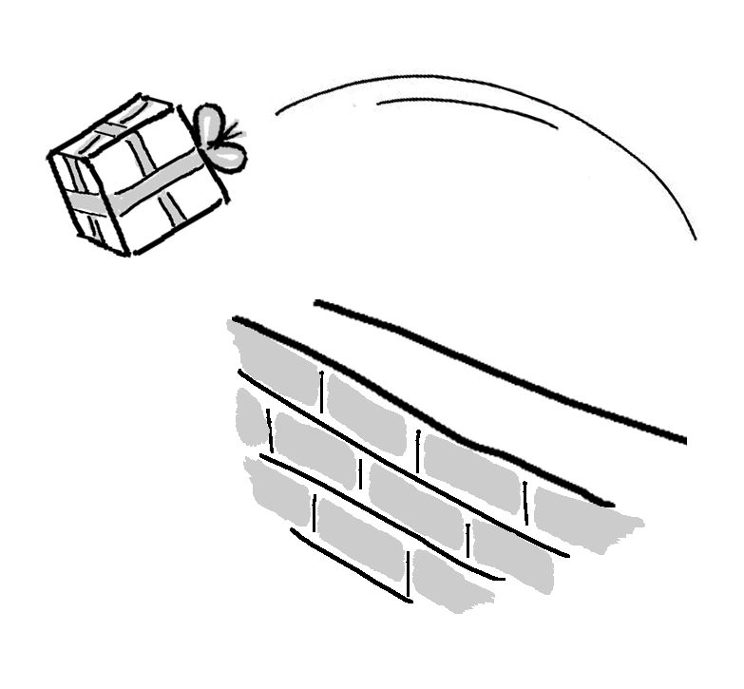
Not covered: product integration
There's a complex network of dependencies (see people enumerated previously) of which data science is one component.
Downstream consumers of your output are likely to be software developers who use containers and support users.
This class is focused on the data science; not with integration.
See http://dev2ops.org/2010/02/what-is-devops/

Slide 27

Not covered: security
We focus on data science techniques; these do not emphasize secure design of software.
Notes:
https://betanews.com/2014/04/15/windows-8-1-without-update-will-no-longer-receive-security-updates/

Slide 28
We will discuss: data formats
Examples of data formats
CSV
Excel
JSON
XML
Images (i.e. png, jpg, bmp, svg)
Sound (i.e. mp3, wav)
Images + sound: video
Unstructured text (i.e. txt)
Notes:
An outline of what I plan to cover in Data 601
https://www.loc.gov/preservation/resources/rfs/
https://www.loc.gov/preservation/resources/rfs/TOC.html
https://www.loc.gov/preservation/resources/rfs/stillimg.html#photodigital

Slide 29
Not covered:
unstructured text
Not covered:
image, sound, video
Data 601 focus is on numerical data

Slide 30
Tables: what are they good for?
How would you represent a corpus of emails?
How would you represent course grades for Data 601?

Slide 31
data
CSV
JSON
XML
Excel
Images
Sound
Video
Unstructured text
Plain text
Platform independent
Not tied to specific software
--> Recommended as data formats by the Library of Congress
See http://www.loc.gov/preservation/resources/rfs/data.html
Notes:
An outline of what I plan to cover in Data 601
https://www.loc.gov/preservation/resources/rfs/
https://www.loc.gov/preservation/resources/rfs/TOC.html

Slide 32
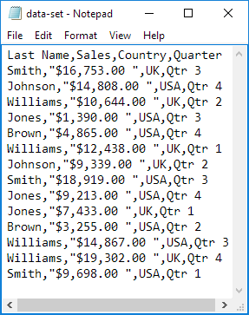


CSV
No set standard; see https://tools.ietf.org/html/rfc4180
https://en.wikipedia.org/wiki/Comma-separated_values
A table with rows and columns composed of text
Notes:
https://www.excel-easy.com/examples/import-export-text-files.html

Slide 33
CSV
No set standard; see https://tools.ietf.org/html/rfc4180
https://en.wikipedia.org/wiki/Comma-separated_values
A table with rows and columns composed of text
Two delimiters (https://en.wikipedia.org/wiki/Delimiter):
Line break
Comma
May or may not have a header:
First row is descriptions of columns
Notes:
https://www.excel-easy.com/examples/import-export-text-files.html

Slide 34
CSV caveats
Text (not images, audio, video)
Each column of same type
Name or word or description (text)
Number
Category label (text)
Delimiters within a value
Enclosed within a pair of double quotes: " "
Quotes for quotes, ie 24"
Notes:
Image: https://www.excel-easy.com/examples/import-export-text-files.html
https://tools.ietf.org/html/rfc4180
https://stackoverflow.com/questions/17808511/properly-escape-a-double-quote-in-csv

Slide 35
CSV variations
Delimiters vary:
Tab – see https://en.wikipedia.org/wiki/Tab-separated_values
| (pipe)
Month|count|location
Jan|1332|here
June|5,593|there
Feb|953,24|everywhere, CA
Oct|592|my home town, MD
Notes:
https://en.wikipedia.org/wiki/Delimiter-separated_values

Slide 36
CSV alternative: fixed width
Consistent number of characters per column
ID l_name f_nametuition
0585822Potter, JrHarry 204
0485572Weasley Ron 958
5924245Granger Hermio422
4724926Diggory Cedric1042
4938243Weasley Fred 394
Notes:
https://www.excel-easy.com/examples/import-export-text-files.html

Slide 37
CSV alternative: fixed width
Consistent number of characters per column
ID l_name f_nametuition
0585822Potter, JrHarry 204
0485572Weasley Ron 958
5924245Granger Hermio422
4724926Diggory Cedric1042
4938243Weasley Fred 394
Caveat: each column needs to be at least as long as the longest entry
Notes:
https://www.excel-easy.com/examples/import-export-text-files.html

Slide 38
CSV quiz

Slide 39
Jupyter and CSV

Slide 40
Data format: JavaScript Object Notation (JSON)
https://tools.ietf.org/html/rfc4627
Notes:
https://www.w3schools.com/js/js_json_intro.asp
https://beginnersbook.com/2015/04/json-tutorial/
https://www.tutorialspoint.com/json/

Slide 41
Data format: Extensible Markup Language (XML)
https://tools.ietf.org/html/rfc2376
Notes:
https://www.w3schools.com/xml/
https://www.w3schools.com/xml/xml_whatis.asp
https://www.tutorialspoint.com/xml/

Slide 42
What is Science?
Science is a systematic enterprise that builds and organizes knowledge in the form of testable explanations and predictions about the universe.
https://en.wikipedia.org/wiki/Science
Notes:
https://web.stanford.edu/class/stats101/intro/intro-lecture01.pdf

Slide 43
How to Science
Observation
= Data
Test
= (in)validate assumptions
Curiousity about relations
Model = a story using math
to describe relations
in the data
Prediction
= based on assumptions
Notes:
https://www.youtube.com/watch?v=j12BBcKSgEQ

Slide 44
Make a claim, test the claim
A claim should be falsifiable. The test should be statistically meaningful.
In practice, strictness depends on intended outcome.
Good enough to make money:
Altering what color the button on your ecommerace website is to maximize sales
Recommending a movie to viewers
Critical to safety or health of humans:
Determining which dosage of a drug is efficacious for medical treatments
Guidance for an autonomous vehicle

Slide 45
Reproducibility
Someone else, following only your documentation, should be able to get an outcome that validates your claim
Example reasons why reproducibility fails
The outcome was specific to the data used
Assumptions were wrong
Software implementation has a bug
Documentation provided is insufficient to enable reproducibility
Notes:
https://en.wikipedia.org/wiki/Reproducibility
https://en.wikipedia.org/wiki/Replication_crisis

Slide 46
Best practices: Version control
Regardless of how you develop analytics, you'll be creating or editing software and documents.
[lesson] Regardless of how you implement best practices, avoid inventing solutions for which someone else already provided a path.
Suggested resource: https://try.github.io/

Slide 47

Have you used software for version control?
Examples: git, svn, hg
Notes:
https://harveymilk.com/hmcra-family-survey-2/

Slide 48
Data science is more than math and software
human interaction in data science
discovering stakeholders
negotiating with data owners
customer engagement
https://hbr.org/2017/01/the-best-data-scientists-get-out-and-talk-to-people

Slide 49
Iterating with customers
as a data scientist, you'll often be working for someone other than yourself.
Expect under-specified requirements from customers. Iterate.
Provide incomplete solutions rather than waiting until the product is perfect.
https://en.wikipedia.org/wiki/Minimum_viable_product

Slide 50

When to persist, When to change course, When to seek help
Try attacking the challenge for 30 minutes
Then seek help or do something else for a while
https://en.wikipedia.org/wiki/Pomodoro_Technique
Notes:
http://finalfantasy.wikia.com/wiki/Level_grinding
https://en.wikipedia.org/wiki/Grinding_(gaming)
https://www.vectorstock.com/royalty-free-vector/timer-sign-icon-30-minutes-stopwatch-symbol-vector-3756908

Slide 51
Pro-tip when seeking help
How to ask well-formed questions:
https://stackoverflow.com/help/how-to-ask
[Intentional sidetrack to StackOverflow.]

Slide 52


emotions in data science
As a data scientist, most of your time will be spent in a desert of uncertainty, frustration, and doubt.
There will be rare short-lived interspersed spikes of excitement and happiness due to events like getting a new dataset, creating a new analytic, getting a new result, or being thanked by a stakeholder.
This experience is normal and does not go away.
Notes:
https://www.vhtcx.com/wp-content/uploads/2015/02/canstockphoto3986275.jpg
https://www.vhtcx.com/blog/5-causes-customer-frustration-fix/

Slide 53
Task: be able to use Jupyter
Web-based (free, no guarantee of availability)
https://colab.research.google.com/
https://mybinder.org/
Depends on reference to github repository
Local installation on your computer
https://jupyter.org/install
Requires Python

Slide 54
External resources
Slack channel for Data 601: https://umbcdatasci.slack.com/messages/
Meetups
https://www.meetup.com/topics/data-science/
Online courses
Coursera
https://www.coursera.org/learn/machine-learning/home/welcome

Slide 55
Homework
Select one of the following texts:
first 10 pages of "50 years of data science"
or
A Very Short History Of Data Science
Write a half page summary of the text
Bring your summary to class on Sept 6, 2018
Notes:
Timeline: http://www.dataversity.net/brief-history-data-science/

